Slide 1
Weekly Report
Presenter: Kuan-Hsun-Duh
Advisor: Cheng-Wen Wu
2021/07/22

Slide 2
Outline
Power system
Zero sequence current
BTB system
Swiching component
Motor drive system
Harmonic current effect
Proposed BTB system/Motor drive system
Conclusion & Future Work

Slide 3
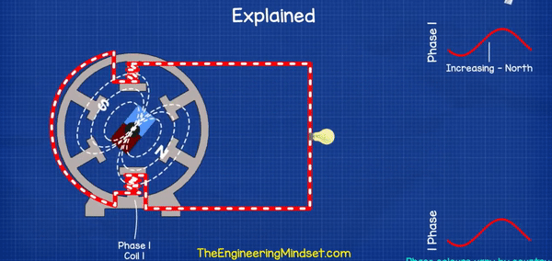
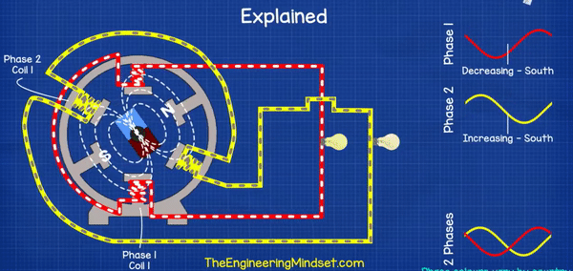
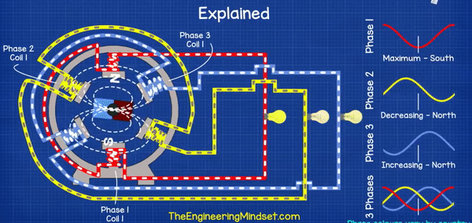
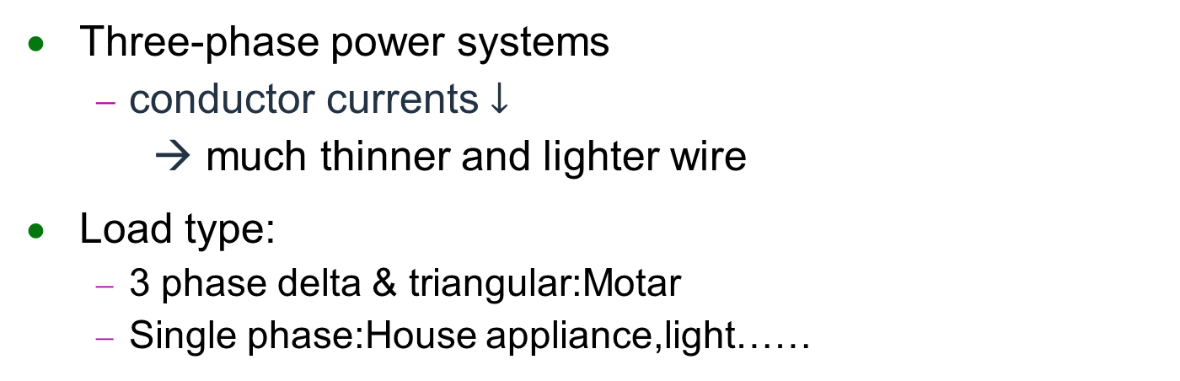
Power System
Three-phase power systems
conductor currents $↓$
→ much thinner and lighter wire
Load type:
3 phase delta & triangular:Motar
Single phase:House appliance,light……
REF. Paul Evans 2018 2 the Engineering Mindset.com
England Lancaster University

Slide 4
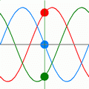
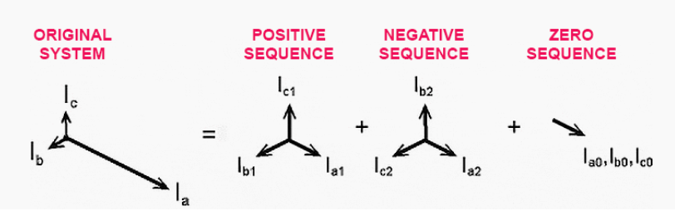
Zero Sequence Current
Phase currents aren’t equal and displaced not by exactly 120°
Different phase component
Positive sequence current
Negative sequence current
Result in twice flux and rotational velocity
Eddy currents and heating problem
Zero sequence current
n-phase network will sum to n times the magnitude
Figure.1
Ideal 3 phase current

Slide 5
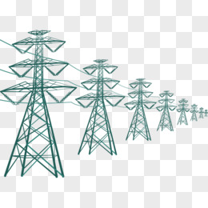
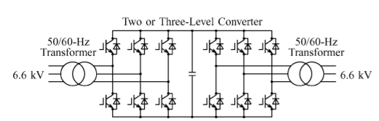
Back To Back System
Application:
HVDCT(High Voltage Direct Current Transmission)
Tradictional:
2 PWM Converter connect together prevent zero sequence current problem
Cons:Bulky
2 generation:change switching as
IGCT (Integrated Gate-Commutated Thyristor)
IEGT(Injection Enhanced Gate Transistor)
Cons: Zero Sequence Current happened

Slide 6
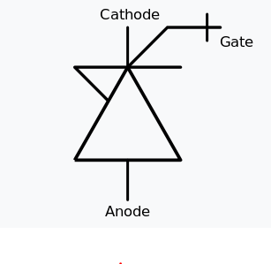
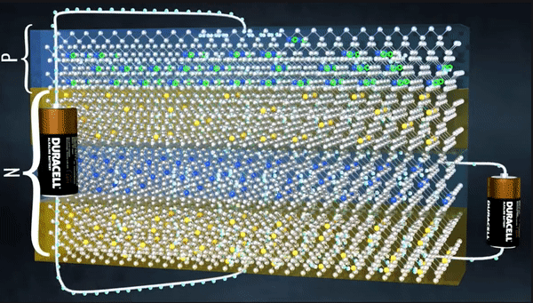
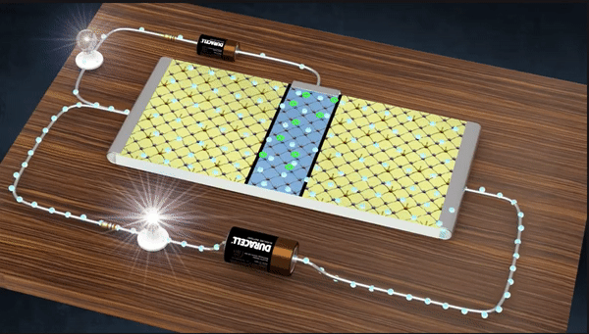
Switch Component
Device characteristic | Power bipolar | Power MOSFET | Power MOSFET | IGBT | IGBT | IEGT | GTO | IGCT
Transistor |  |  |  |  |  |  | Thyristor
Voltage rating | <1kV | <1 kV |  | >1 kV |  | >4kv | Higher than transistor
Gate turn-off thyristor (GTO)
Integrated gate-commutated thyristor(IGCT)
Frequency:
Power MOSFET>IGBT(10kHz)
Automotive electronics
IGCT(kHz)>GTO(100~800Hz)
Figure2. IGCT
N
P
P
N
P
N
P
Notes:
IGBT lifetime is ten times greater than IGCT.
3 layer vs 4 layer

Slide 7
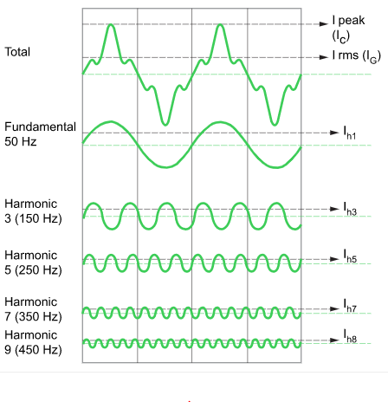
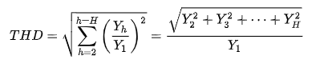
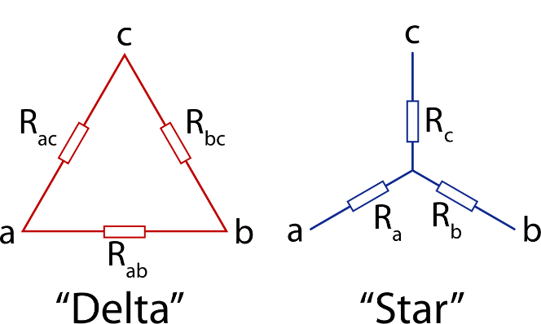
Harmonic current effect
Origin: nonlinear load(diode,transistor……..)
Total Harmonic Distortion (THD)
Reduce method:
Delta connections control
3rd harmonic current

Slide 8
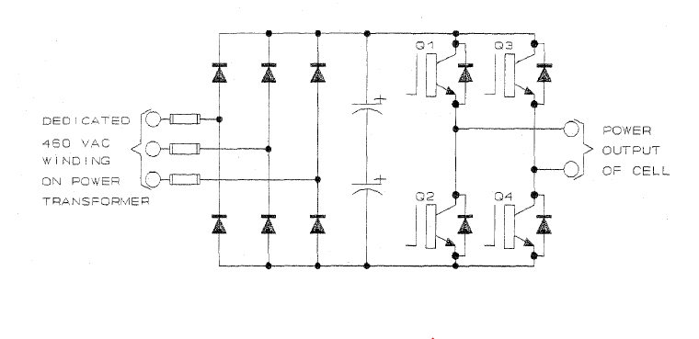
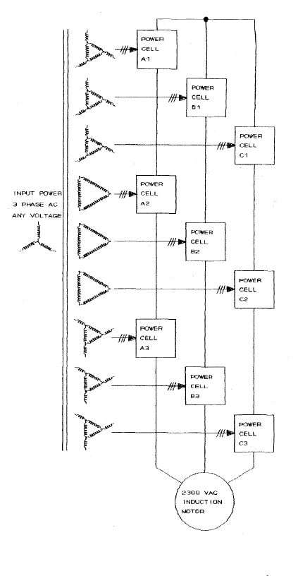
Motor drive system
Pros:
Reduce harmonic current effect(caused by nonlinear component)
Cons:
Can’t regernerate power back to the system
REF.A new approach to enhance power quality for medium voltage AC drives
P. W. Hammond Jan.-Feb. 1997 IEEE ASIRobicon USA
Notes:
整流擺放位置導致無法回沖

Slide 9
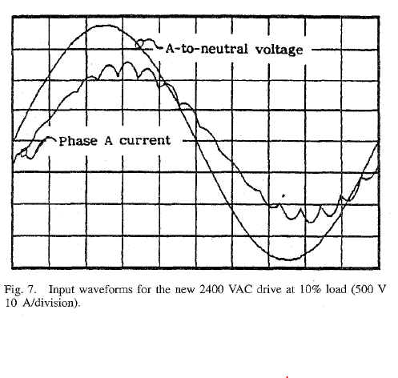
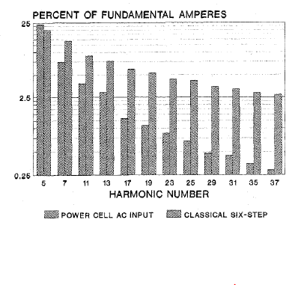
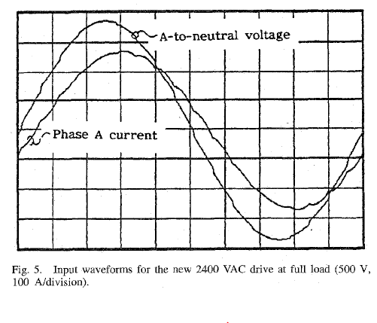
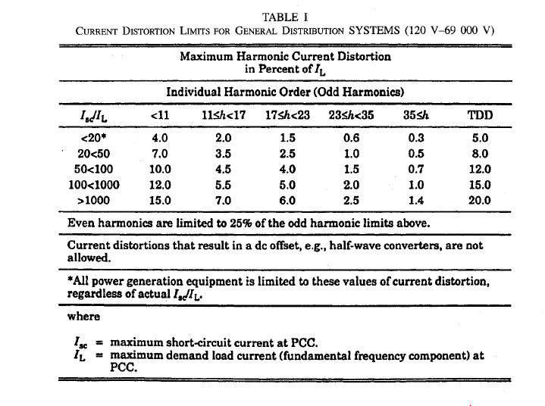
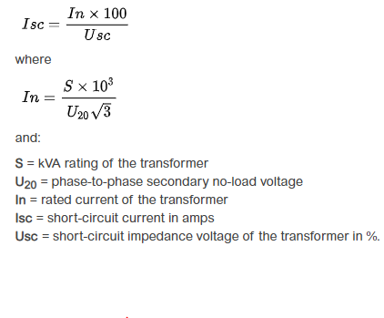
Motor drive system result
IEEE Standard 519-1922
REF.A new approach to enhance power quality for medium voltage AC drives
P. W. Hammond Jan.-Feb. 1997 IEEE ASIRobicon USA

Slide 10
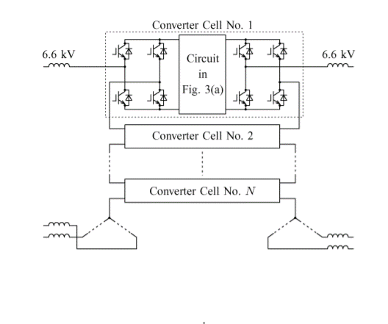
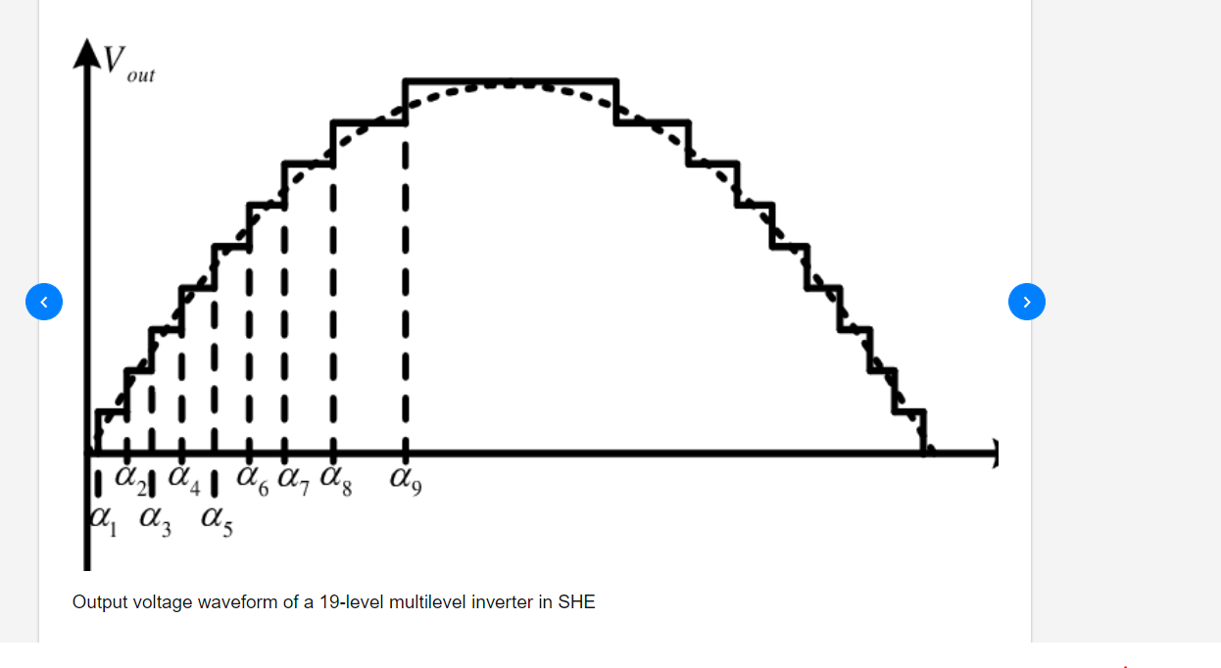
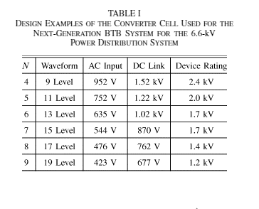
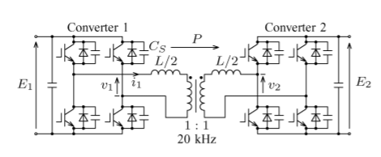
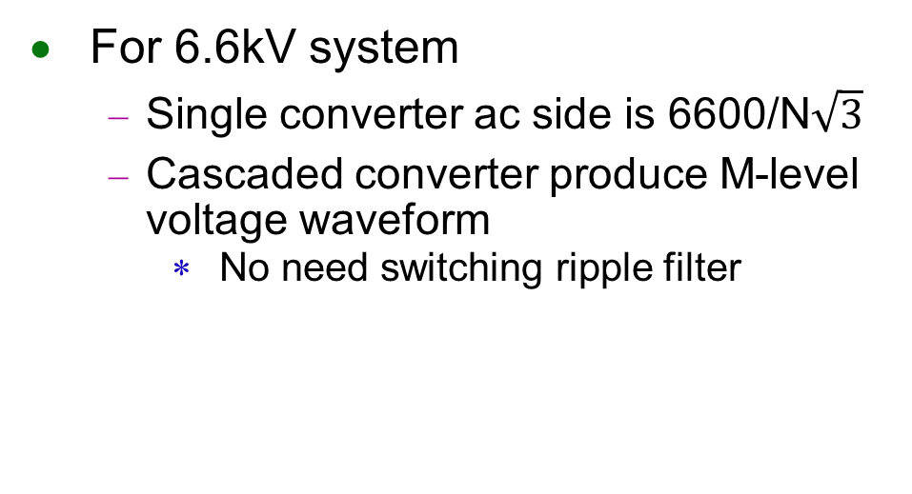
Back To Back System(proposed)
For 6.6kV system
Single converter ac side is 6600/N$\sqrt{3}$
Cascaded converter produce M-level voltage waveform
No need switching ripple filter
AC
DC
DC
AC
DC
AC
AC
DC
REF. A Bidirectional Isolated DC–DC Converter as a Core Circuit of the Next-Generation Medium-Voltage Power Conversion System
March 2007
Shigenori Inoue
Tokyo Institute of Technology

Slide 11
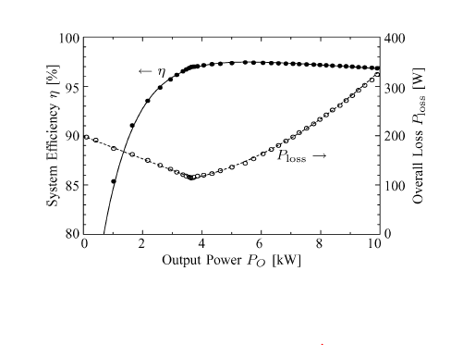
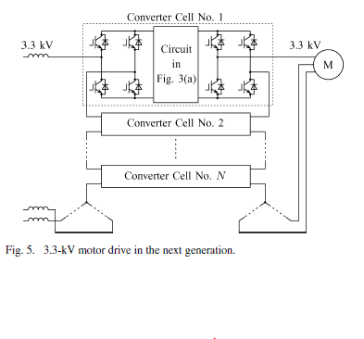
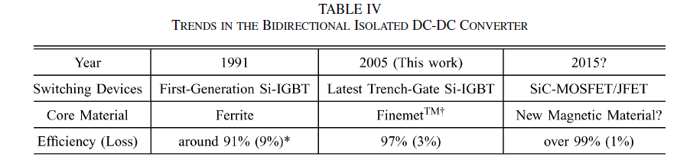
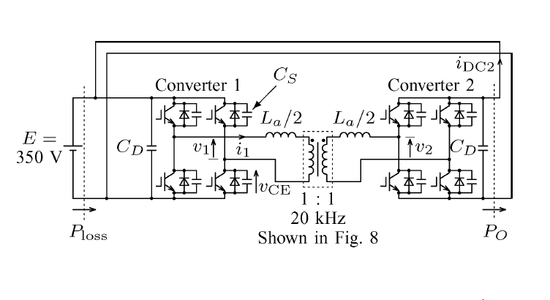
Motor drive system(proposed) Result
Model spec
Power:10kW
Votage:350V
20kHz
Zero voltage switching loss
Conducting loss
REF. A Bidirectional Isolated DC–DC Converter as a Core Circuit of the Next-Generation Medium-Voltage Power Conversion System
March 2007
Shigenori Inoue Tokyo Institute of Technology

Slide 12
Conclusion & Future Work
Analyze method
Zero sequence current
Harmonic current effect
IEEE Standard 519-1922
LTSPICE environment setup
(8/12 will have a online lesson)
Design simple circuit(RC circuit)
REF. Passive Circuit Analysis with Ltspice 2020 11 author:May, Colin Percy University of Westminster

Slide 13
END

Slide 14
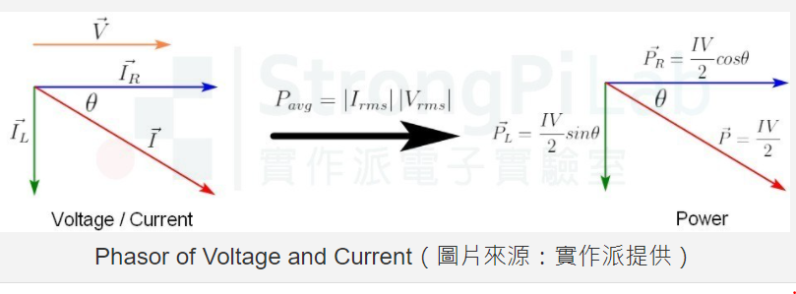

Slide 15
19 level waveform

Slide 16
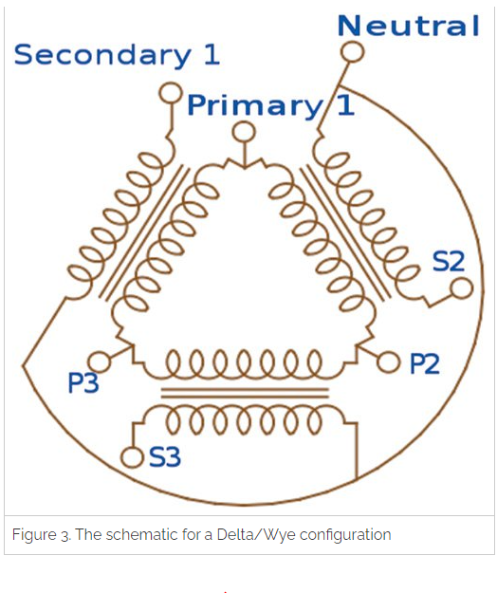

Slide 17
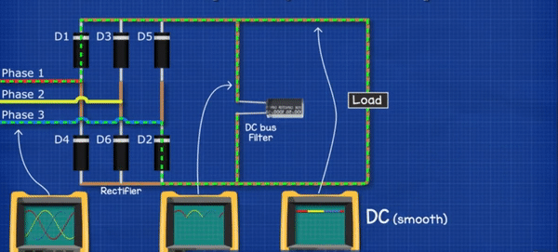
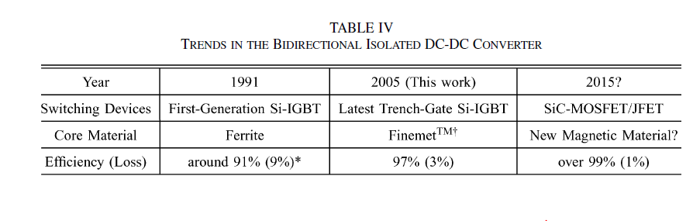
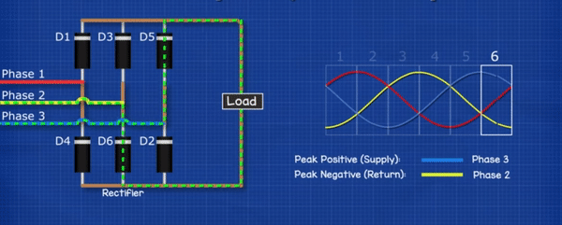
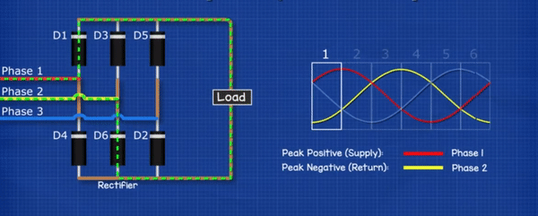

Slide 18
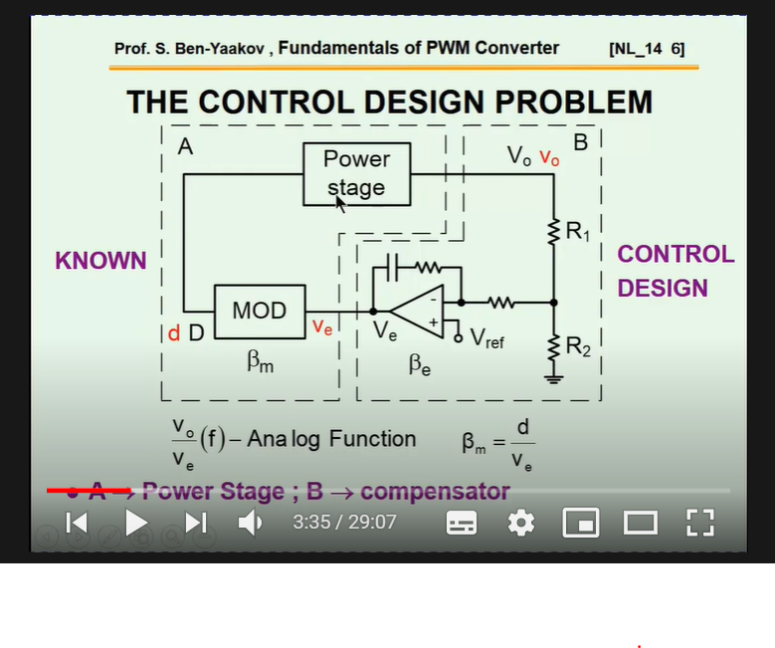

Slide 19
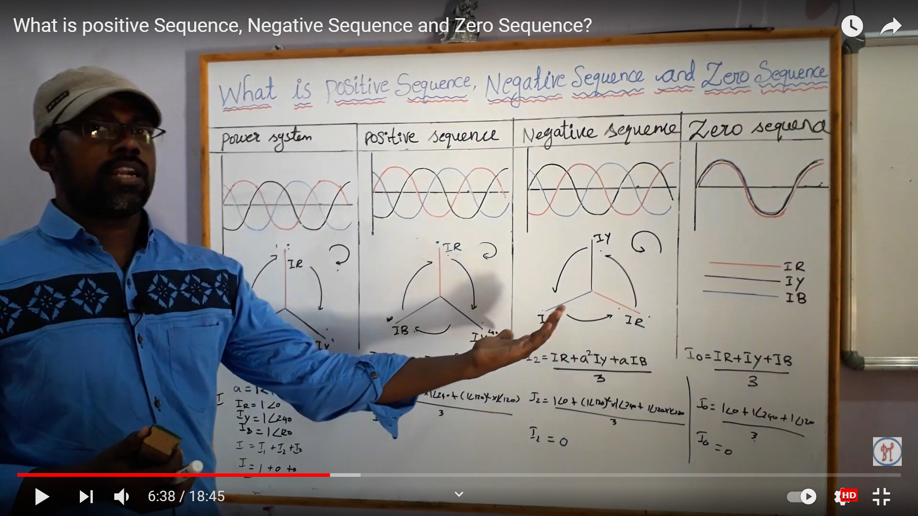
在同一power system 下 掛載三種不同附載

Slide 20
